Slide 1

Project Management: Achieving Competitive Advantage
Fifth Edition
Chapter 6
Project Team Building, Conflict, and Negotiation
Copyright © 2019, 2016, 2013 Pearson Education, Inc. All Rights Reserved
Notes:
If this PowerPoint presentation contains mathematical equations, you may need to check that your computer has the following installed:
1) MathType Plugin
2) Math Player (free versions available)
3) NVDA Reader (free versions available)

Slide 2
Effective Project Teams
Clear Sense of Mission
Productive Interdependency
Cohesiveness
Trust
Enthusiasm
Results Orientation

Slide 3
Reasons Why Teams Fail
Poorly developed or unclear goals
Poorly defined project team roles and interdependencies
Lack of project team motivation
Poor communication
Poor leadership
Turnover among project team members
Dysfunctional behavior

Slide 4
Stages in Group Development
Forming—members become acquainted
Storming—conflict begins
Norming—members reach agreement
Performing—members work together
Adjourning—group disbands
Punctuated equilibrium is a different model.

Slide 5
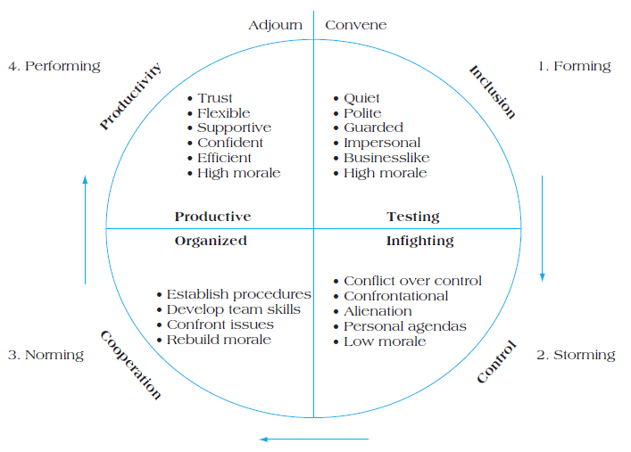
Figure 6.3 Stages of Team Development

Slide 6
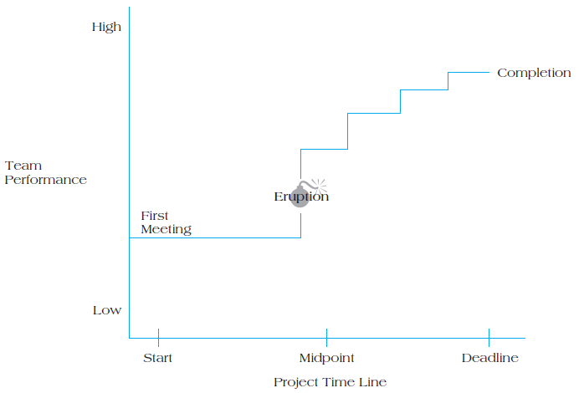
Figure 6.4 Model of Punctuated Equilibrium

Slide 7
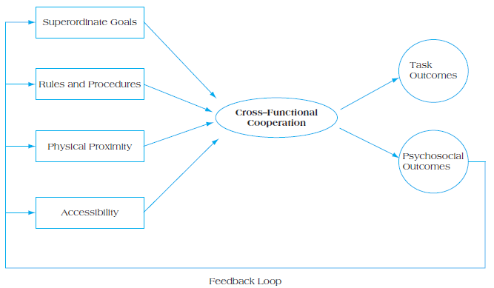
Achieving Cross-Functional Cooperation
Figure 6.5 Project Team Cross-Functional Cooperation

Slide 8
Building High-Performing Teams
Make the project team tangible.
Publicity
Terminology and language
Reward good behavior.
Flexibility
Creativity
Pragmatism
Develop a personal touch.
Lead by example
Positive feedback for good performance
Accessibility and consistency

Slide 9
Virtual Project Teams
Use electronic media to link members of a geographically dispersed project team.
How Can Virtual Teams Be Improved?
Use face-to-face communication when possible.
Don’t let team members disappear.
Establish a code of conduct.
Keep everyone in the communication loop.
Create a process for addressing conflict.

Slide 10
Conflict Management
Conflict is a process that begins when you perceive that someone has frustrated or is about to frustrate a major concern of yours.
Categories
Goal-oriented
Administrative
Interpersonal
Views
Traditional
Behavioral
Interactionist

Slide 11
Sources of Conflict
Organizational
Reward systems
Scarce resources
Uncertainty
Differentiation
Interpersonal
Faulty attributions
Faulty communication
Personal grudges and prejudices

Slide 12
Conflict Resolution
Mediate—diffusion/confrontation
Arbitrate—judgment
Control—cool down period
Accept—unmanageable
Eliminate—transfer
Conflict is often evidence of progress!

Slide 13
Negotiation
Negotiation is a process that is predicated on a manager’s ability to use influence productively.
Questions to Ask Prior to Entering a Negotiation
How much power do I have?
What sort of time pressures are there?
Do I trust my opponent?

Slide 14
Principled Negotiation
Separate the people from the problem.
Focus on interests, not positions.
Invent options for mutual gain.
Insist on using objective criteria.

Slide 15
Thank you

